Slide 1

SWE 425: Telecommunication Engineering
Md. Habibur Rahman
Lecturer
Department of Software Engineering

Slide 2
INTRODUCTION
The User Datagram Protocol (UDP) is called a connectionless, unreliable transport protocol.
It is used primarily for establishing low-latency and loss tolerating connections between applications on the Internet.
UDP is located between the application layer and the IP layer, and serves as the intermediary between the application programs and the network operations.
It performs very limited error checking.
UDP is a very simple protocol using a minimum of overhead

Slide 3
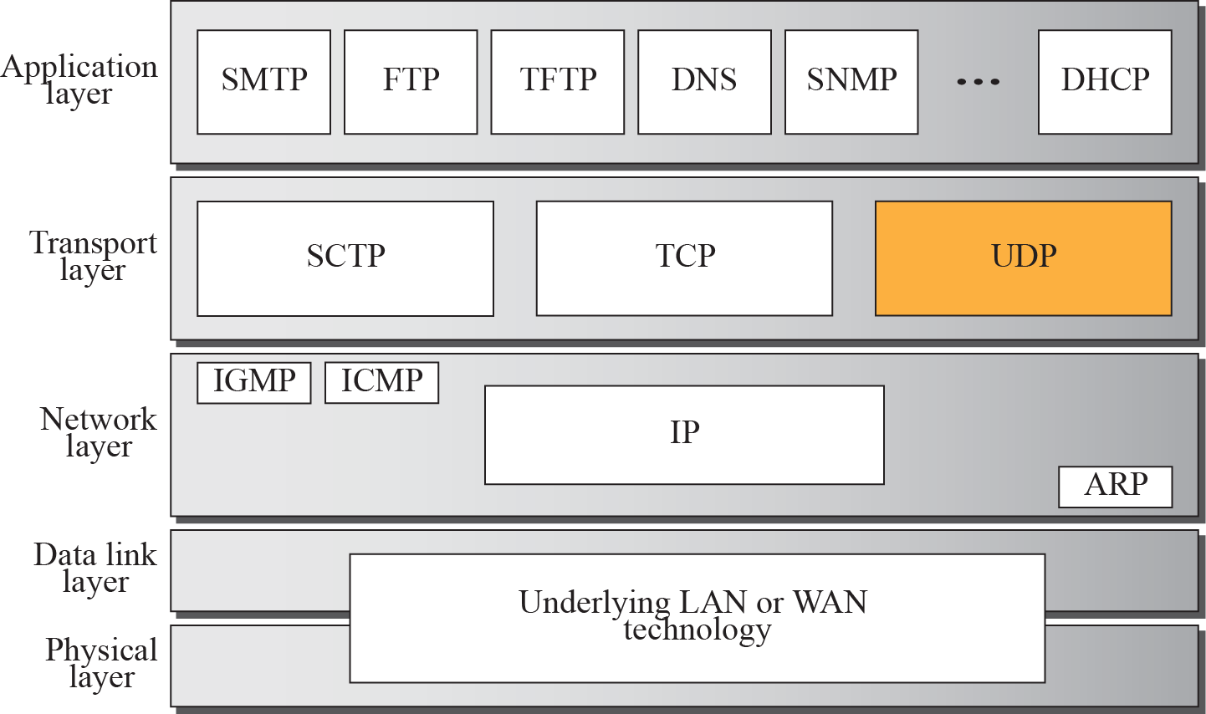
Position of UDP in the TCP/IP protocol suite

Slide 4
USER DATAGRAM
UDP packets, called user datagrams, have a fixed-size header of 8 bytes.
Source port number. This is the port number used by the process running on the source host. It is 16 bits long, which means that the port number can range from 0 to 65,535.
Destination port number. This is the port number used by the process running on the destination host. It is also 16 bits long.
Length. This is a 16-bit field that defines the total length of the user datagram, header plus data.
Checksum. This field is used to detect errors over the entire user datagram (header plus data).

Slide 5
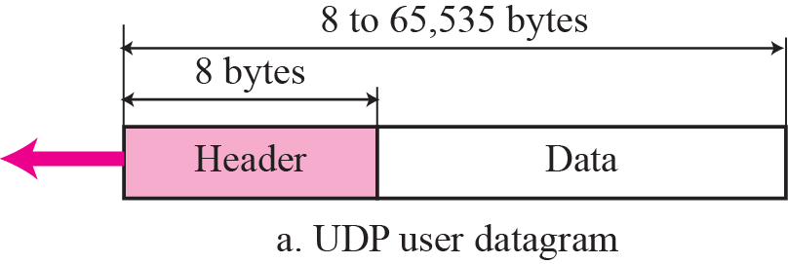
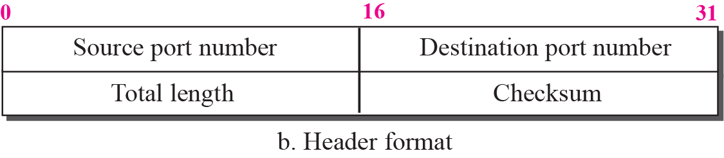
User datagram format

Slide 6
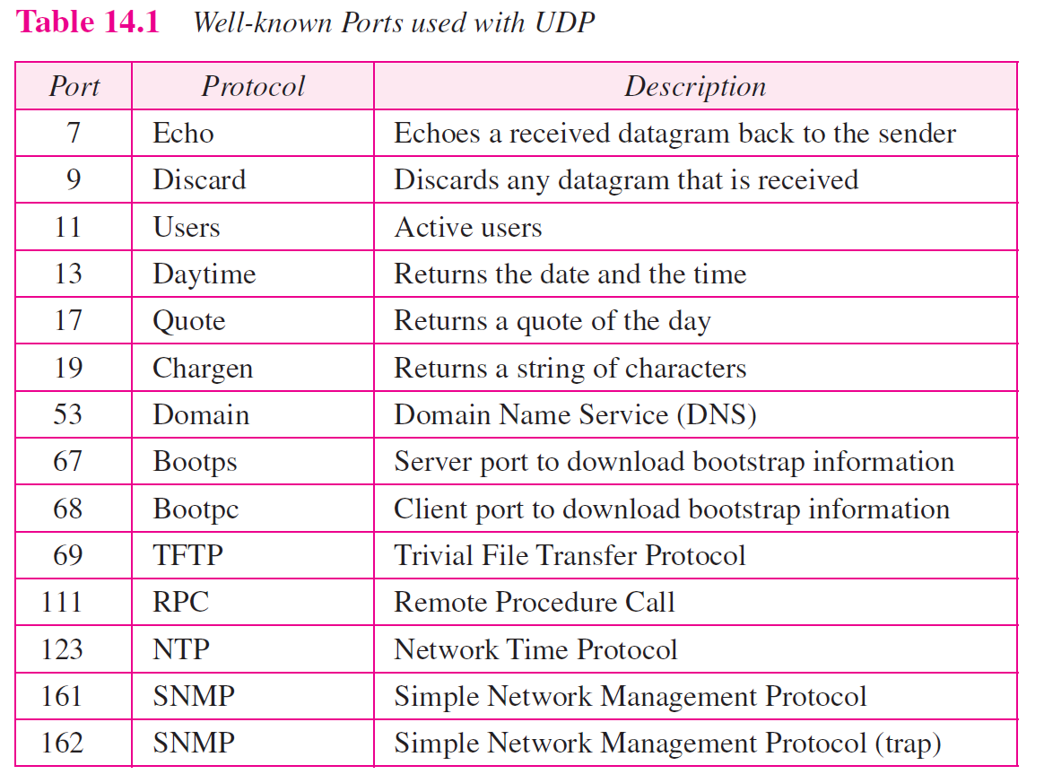

Slide 7
Example 1
The following is a dump of a UDP header in hexadecimal format.
a. What is the source port number?
b. What is the destination port number?
c. What is the total length of the user datagram?
d. What is the length of the data?
e. Is the packet directed from a client to server or vice versa?
f. What is the client process?

Slide 8
Example Continued
Solution
a. The source port number is the first four hexadecimal digits (CB84)₁₆ or 52100.
b. The destination port number is the second four hexadecimal digits (000D)₁₆ or 13.
c. The third four hexadecimal digits (001C)₁₆ define the length of the whole UDP packet as 28 bytes.
d. The length of the data is the length of the whole packet minus the length of the header, or 28 – 8 = 20 bytes.
e. Since the destination port number is 13 (well-known port), the packet is from the client to the server.
f. The client process is the Daytime

Slide 9
Example 2
The following is a dump of a UDP header in hexadecimal format.
14890035011C0021
a. What is the source port number?
b. What is the destination port number?
c. What is the total length of the user datagram?
d. What is the length of the data?
e. Is the packet directed from a client to server or vice versa?
f. What is the client process?

Slide 10
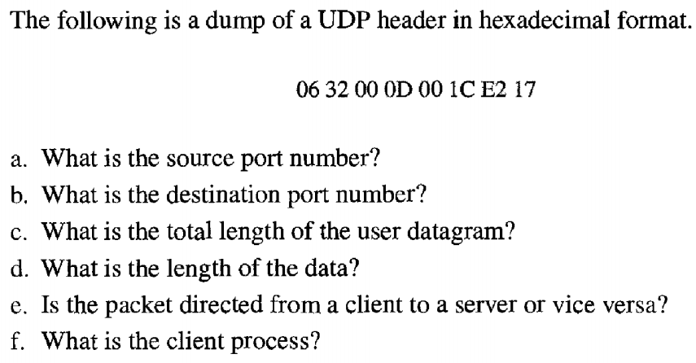
Example 3

Slide 11
UDP Operation
Connectionless Services
UDP provides a connectionless service.
Each user datagram sent by UDP is an independent datagram.
There is no relationship between the different user datagrams even if they are coming from the same source process and going to the same destination program.
The user datagrams are not numbered.
Also, there is no connection establishment and no connection termination, as is the case for TCP. So each user datagram can travel on a different path.
Only those processes sending short messages should use UDP.

Slide 12
UDP Operation
Flow and Error Control
UDP is a very simple, unreliable transport protocol. There is no flow control and hence no window mechanism. The receiver may overflow with incoming messages. There is no error control mechanism in UDP except for the checksum. This means that the sender does not know if a message has been lost or duplicated. When the receiver detects an error through the checksum, the user datagram is silently discarded. The lack of flow control and error control means that the process using UDP should provide these mechanisms.

Slide 13
UDP Operation
Encapsulation and Decapsulation
To send a message from one process to another, the UDP protocol encapsulates and decapsulates messages in an IP datagram.
Queuing
At the client site, when a process starts, it requests a port number from the operating system. Some implementations create both an incoming and an outgoing queue associated with each process. Other implementations create only an incoming queue associated with each process.

Slide 14
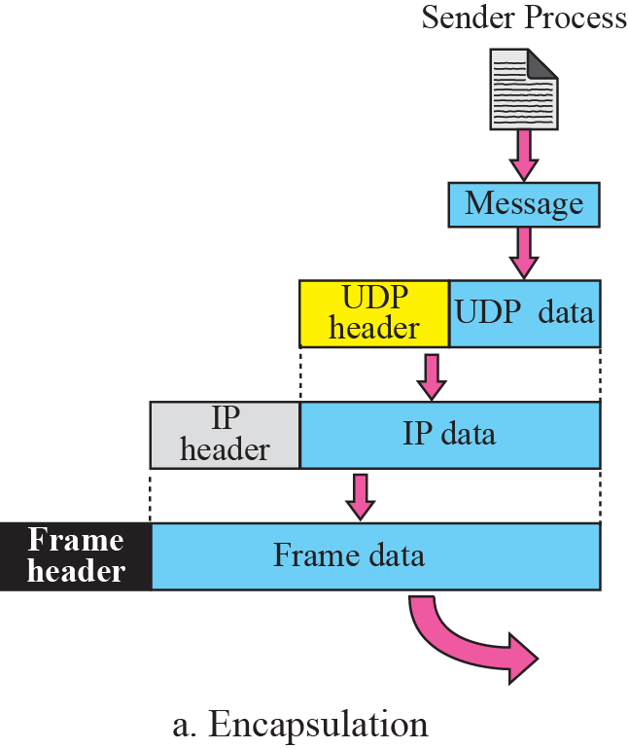
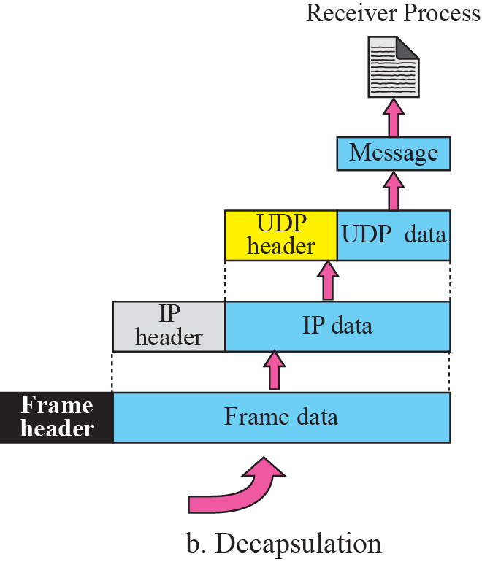

Encapsulation and Decapsulation

Slide 15
Advantages of UDP
Broadcast and multicast transmission are available with UDP which is not the case with TCP.
It doesn't restrict to a connection based communication model, so startup latency in distributed applications is much lower, as is operating system overhead FAST.
All flow control, acknowledging, transaction logging, etc. is up to user programs; a broken OS implementation is not going to get in your way. Additionally, you only need to implement and use the features you need.
The recipient of UDP packets gets them unmingled, including block boundaries.
Much faster than TCP.

Slide 16
Disadvantages of UDP Operation
There are no guarantees with UDP.
A packet may not be delivered, or delivered twice, or delivered out of order; you get no indication of this unless the listening program at the other end decides to say something.
UDP has no flow control, Congestion Control, implementation is the duty of user programs.
Routers are quite careless with UDP. They never retransmit it if it collides, and it seems to be the first thing dropped when a router is short on memory.
Manually breaking of data into packets.
UDP suffers from worse packet loss than TCP

Slide 17
Use of UDP
The following lists some uses of the UDP protocol:
UDP is suitable for a process that requires simple request-response communication with little concern for flow and error control. It is not usually used for a process such as FTP that needs to send bulk data
UDP is suitable for a process with internal flow and error control mechanisms. For example, the Trivial File Transfer Protocol (TFTP) process includes flow and error control. It can easily use UDP
UDP is a suitable transport protocol for multicasting. Multicasting capability is embedded in the UDP software but not in the TCP software.
UDP is used for management processes such as SNMP (Simple Network Management Protocol)
UDP is used for some route updating protocols such as Routing Information Protocol (RIP)

Slide 18
Example of UDP
- Your web browser uses TCP to load webpages but before that uses UDP to translate an URL into an IP address.
- UDP is use for voice because even if some packets are lost this is not a problem. for Example if you call someone and you hire some rumors it's not a problem because you understand . This rumors may be lost packets.
- Playing a game video online
- Streaming movies online
- UDP is used with RTOS (Real time operating systems), which is a high availability control software in civil aircraft.
- Video conference

Slide 19
Thank You !!!
Any Questions ???

